Slide 1
A climate change treaty negotiation lab: Kyoto in an hour
Katherine Straub
Professor and Chair, Dept. of Earth and Environmental Sciences
Susquehanna University, Selinsgrove, PA

Slide 2
Motivation
In introductory survey classes, typically climate change gets only a week or so
Students are often puzzled by the lack of international agreement
This one-hour exercise (plus a bit of background) illustrates the complexities of negotiations

Slide 3
The setup
Each student is assigned to one of 7 countries:
U.S.
China
United Kingdom
Brazil
Japan
Russia
Marshall Islands (representing AOSIS)

Slide 4
The setup
Each group receives an information sheet with the following facts about their country:
Annex I or non-Annex I status
Initial vote
Current percentage of global GHG emissions
Percentage of Annex I GHG emissions in 1990
Primary GHG sources
Projected effects of climate change
Behavior rules
Emissions credits needed to buy/sell
Money to spend

Slide 5
The goal
The goal is to ratify the Kyoto Protocol. This can happen in one of two ways:
Countries ratifying represent >55% of 1990 Annex I nations’ GHG emissions
6 of the 7 countries ratify

Slide 6
Starting info
Country | % of 1990 Annex I emissions | Emissions credits needed | Emissions credits to sell | What are credits for?
US | 36% | 300
Japan | 9% | 200
China | 0% |  | 200 | CDM: Renewables
Marshalls | 0% |  | 100 | CDM: Efficiency
Brazil | 0% |  | 100 | CDM: Trees
UK | 4% |  | 100 | Cap & Trade
Russia | 18% |  | 200 | Cap & Trade
Countries with emissions credits to sell are given an initial asking price and whether or not they can bargain downward in price

Slide 7
Some behavior rules
U.S. doubts the science
China brings up per capita emissions, concern about future commitments
Marshall Islands pushes common but differentiated responsibility
UK wants an agreement with “teeth” (fines)
Brazil worries about enhanced deforestation monitoring
Russia wants UK’s support to join World Trade Organization
Japan/China standoff over Taiwan

Slide 8
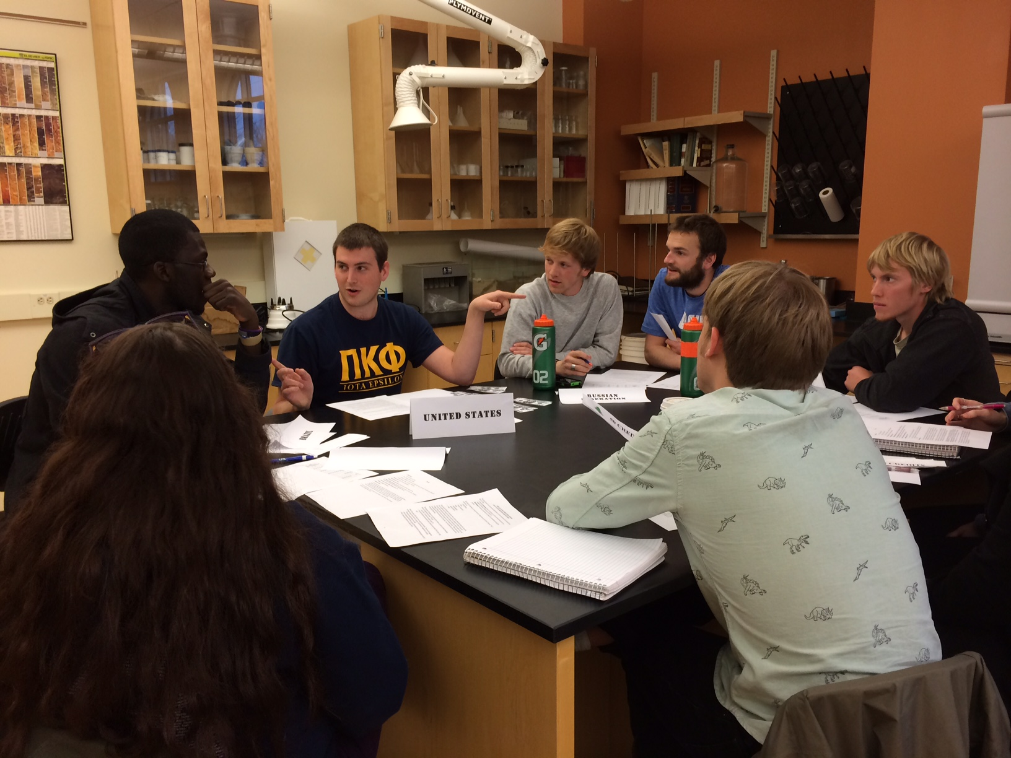
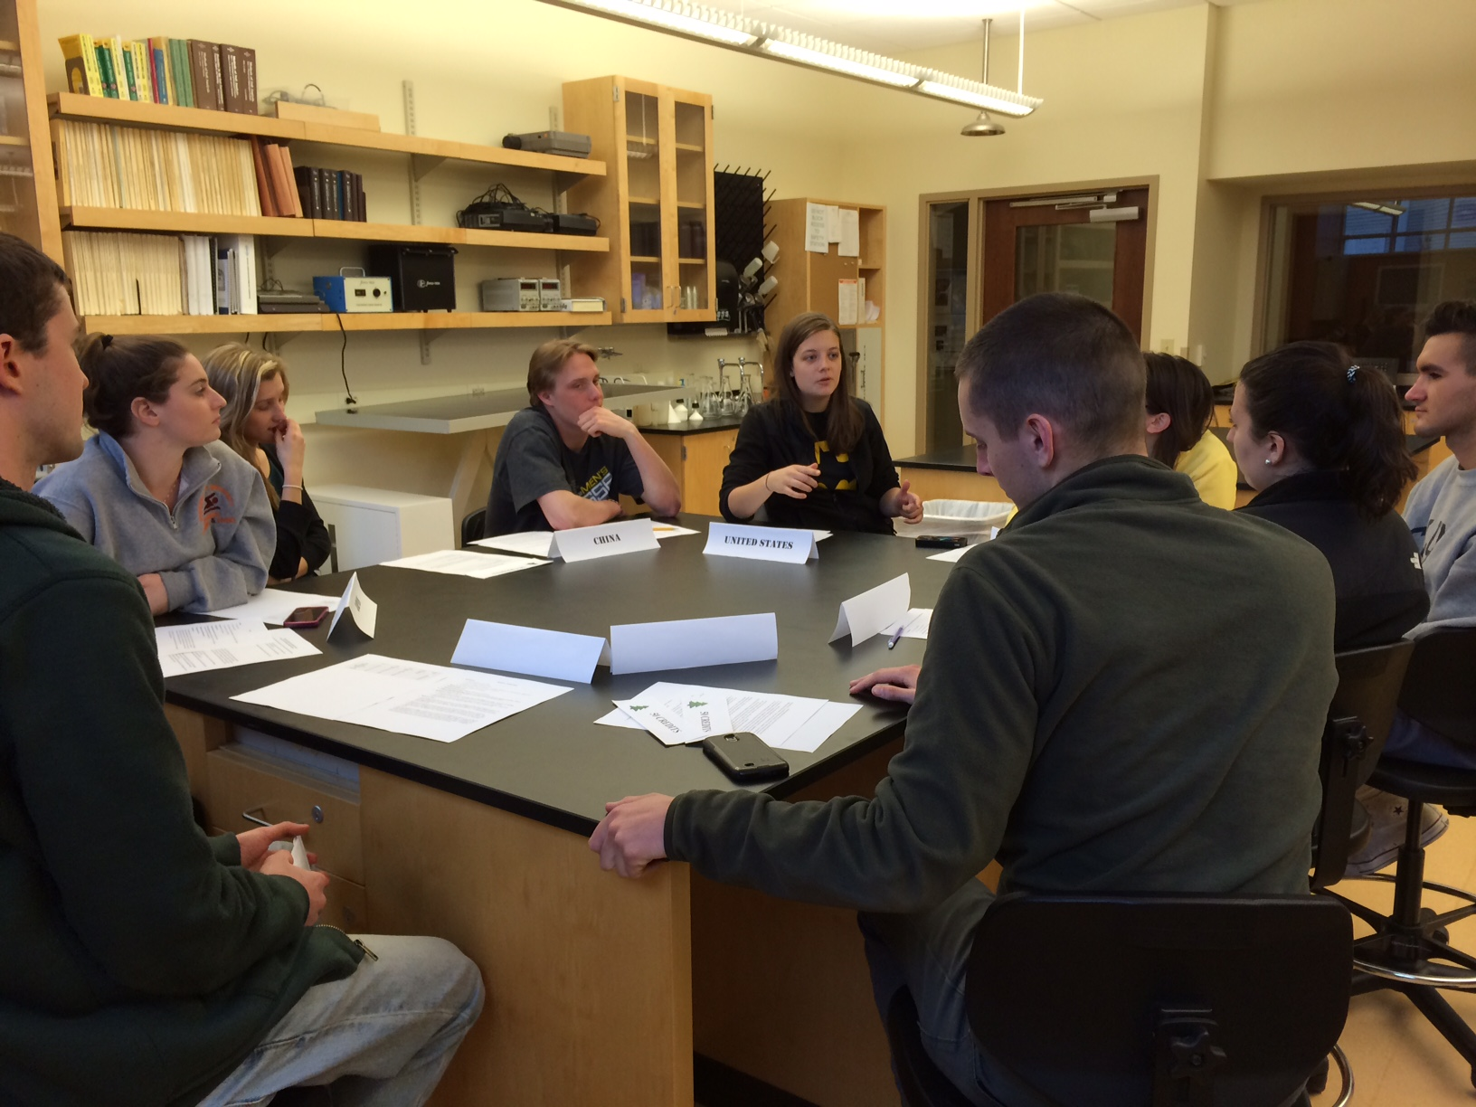
Photos

Slide 9
A wide variety of endings
Secret hallway deals, U.S.-China partnerships, assassinations…
Personalities matter!
Students remark how clearly this exercise portrays the difficulty of negotiating an international climate treaty
Not all about the science!

Slide 10
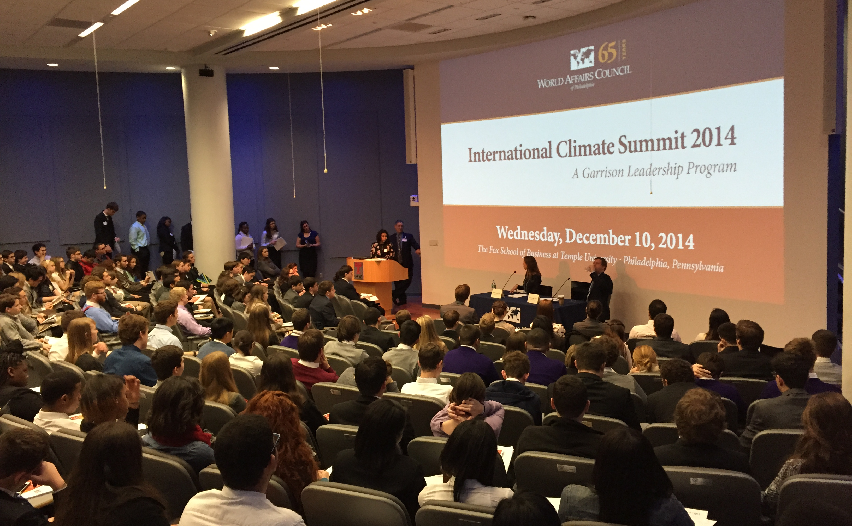
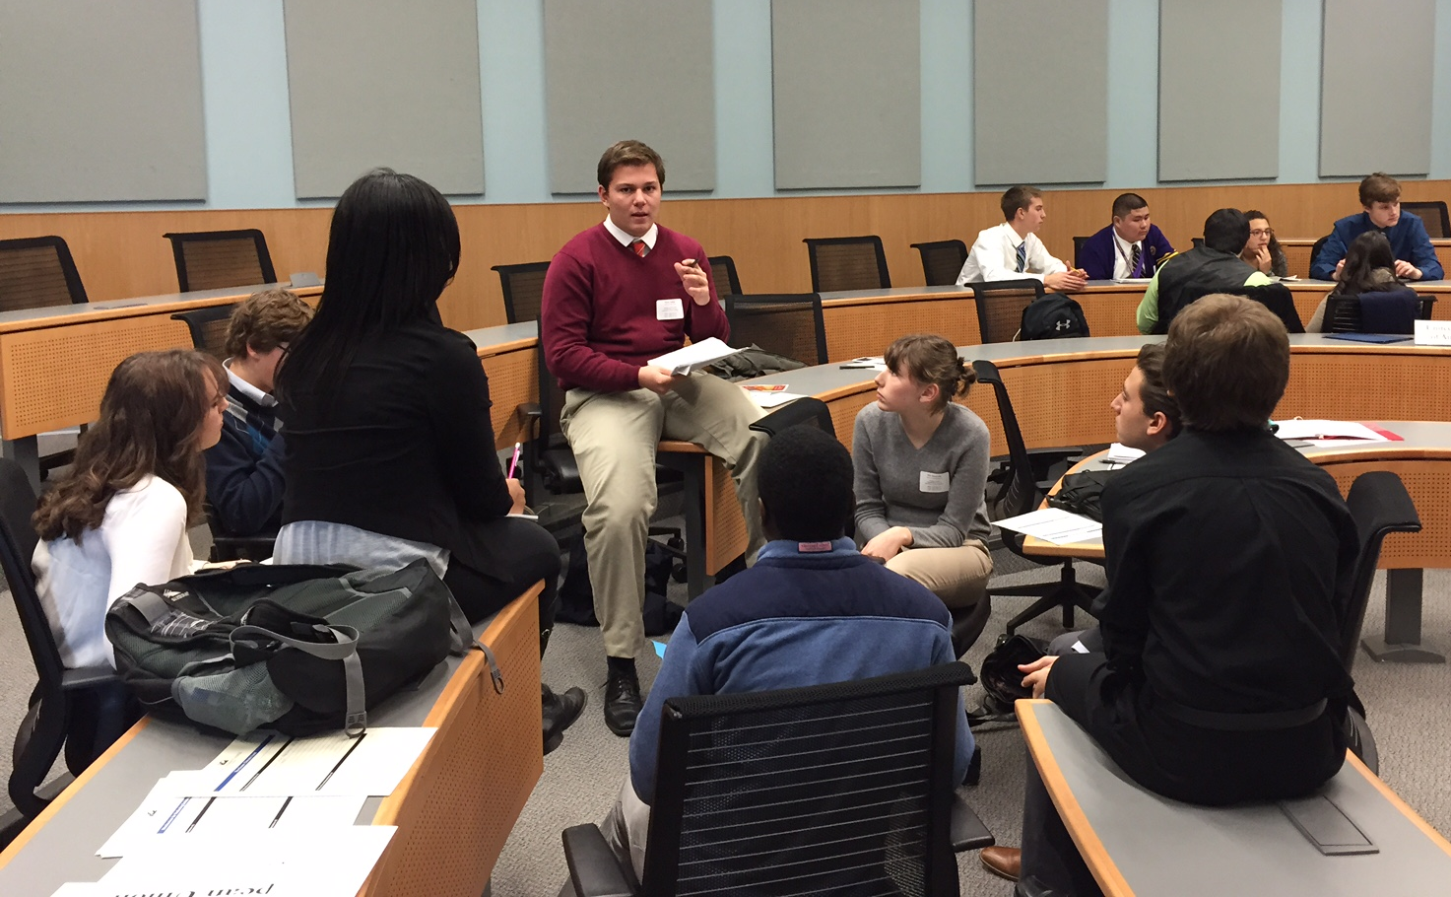
World Affairs Council 2014
300 Philadelphia-area high school students
Negotiated a post-Kyoto climate treaty in preparation for Paris 2015

Slide 11
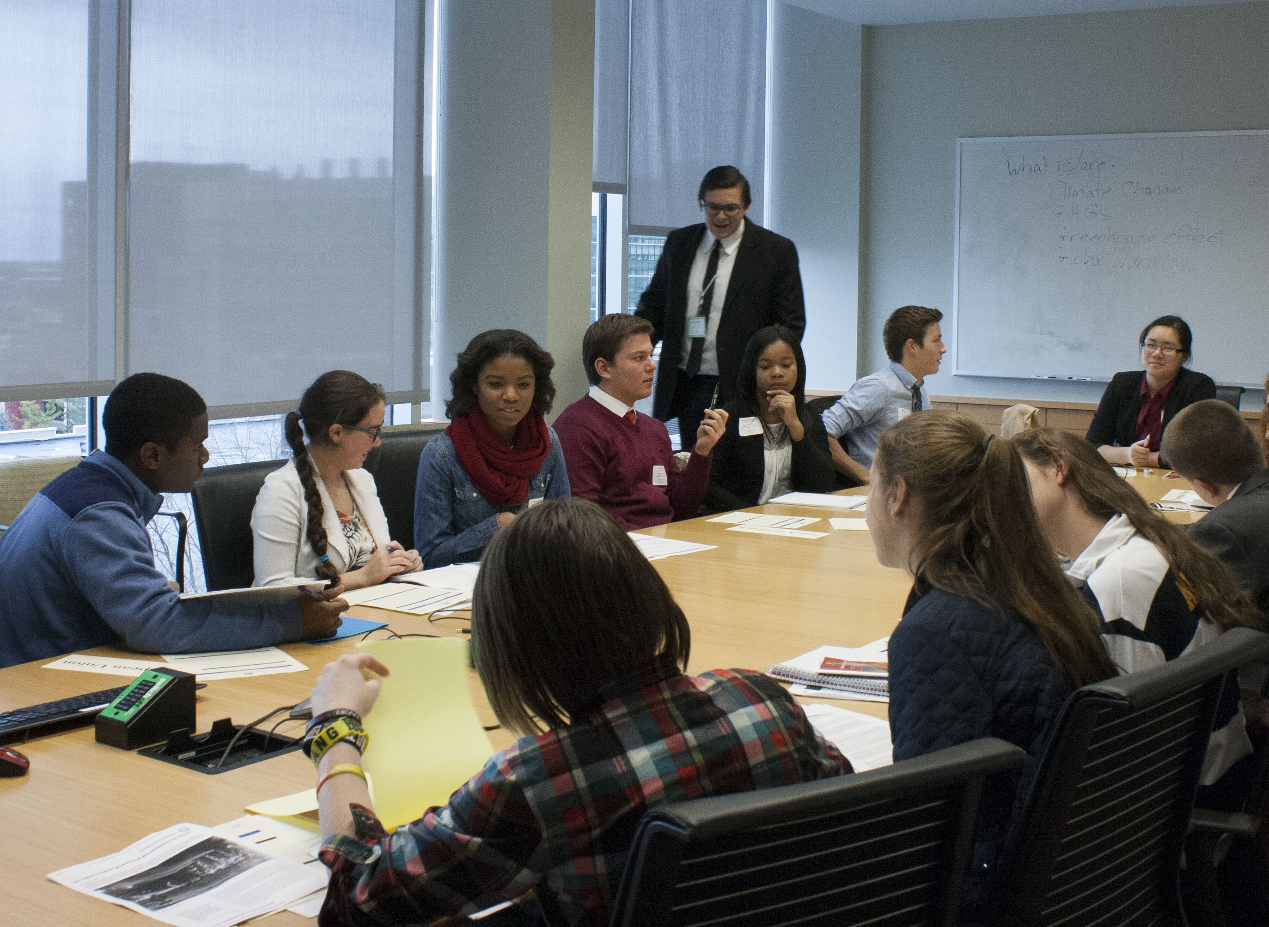
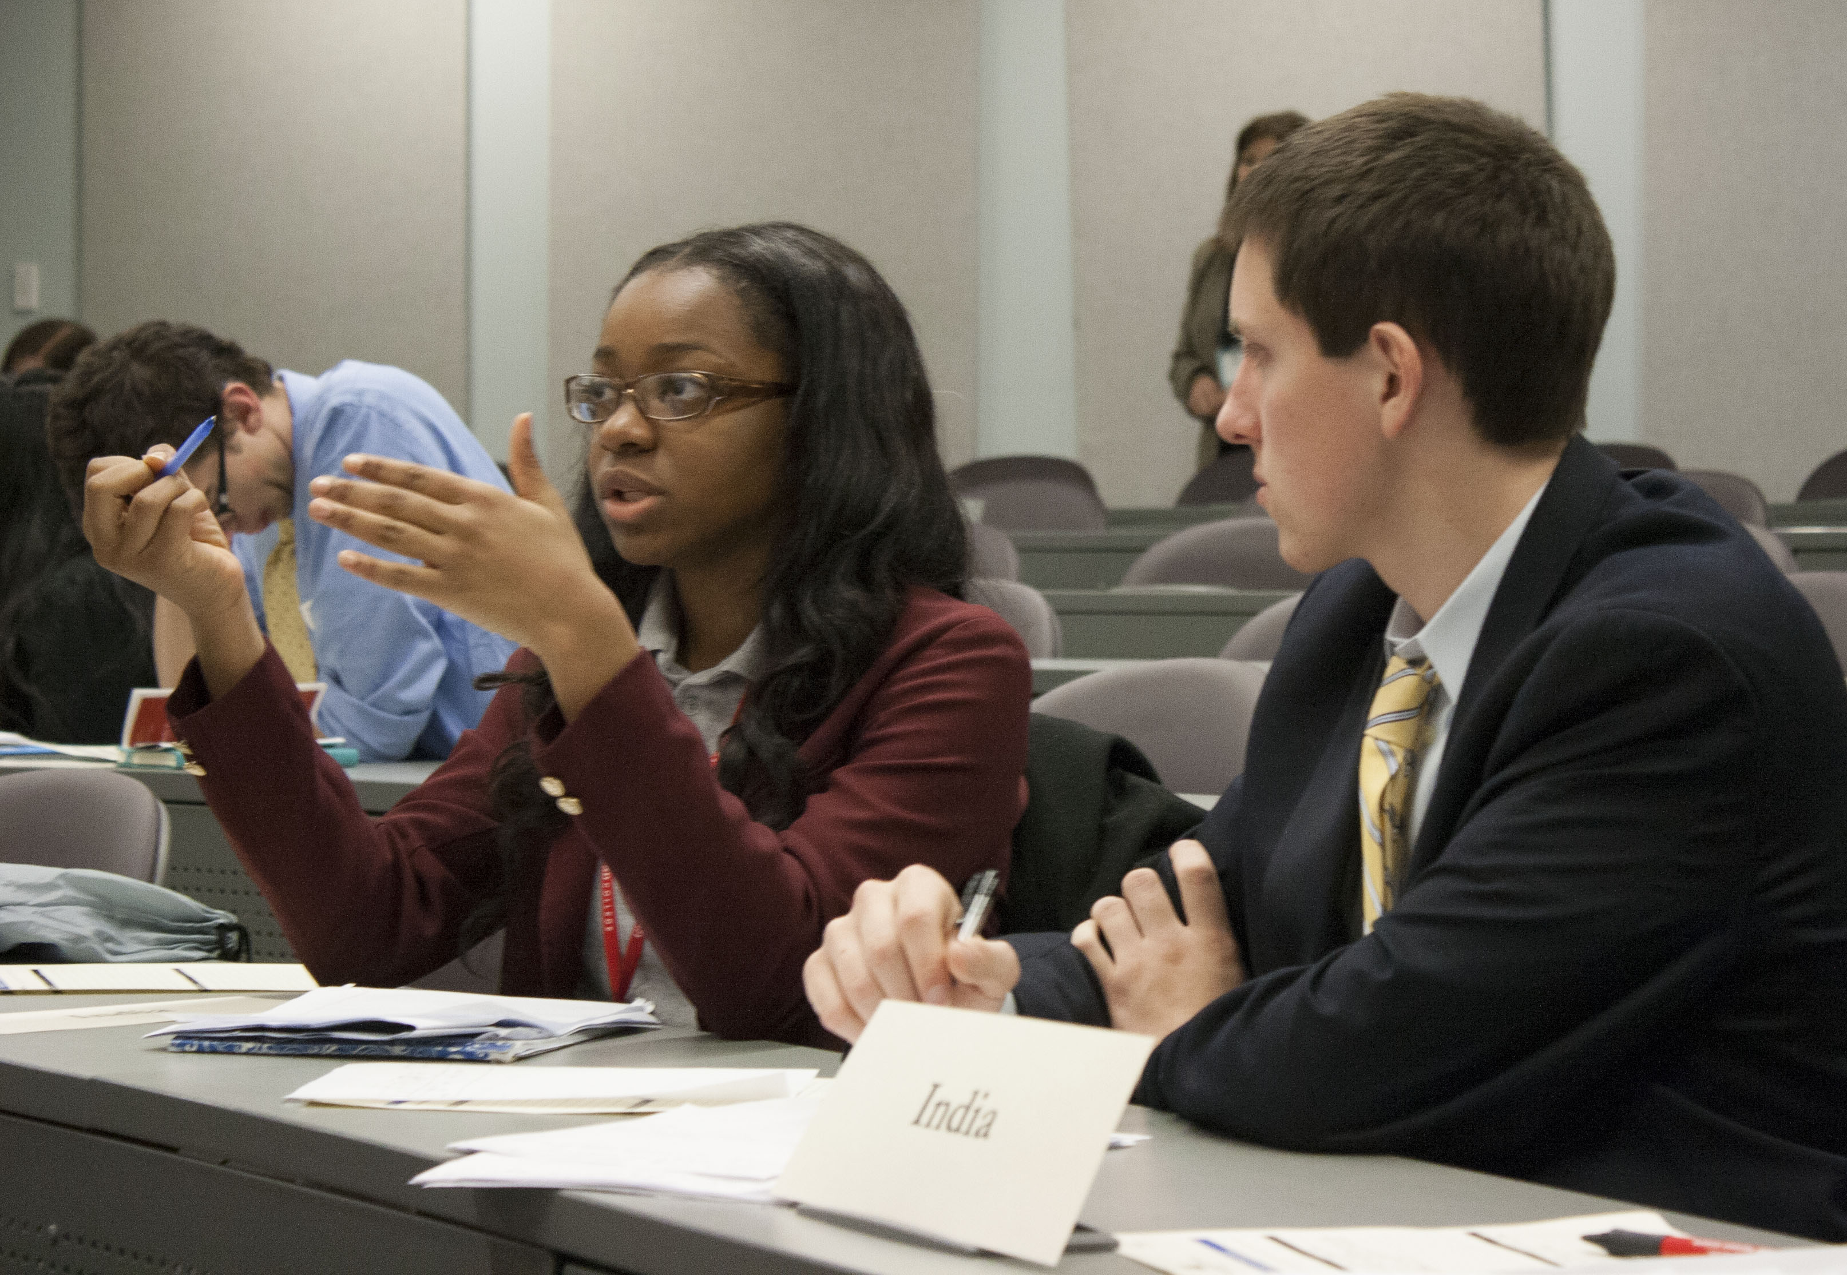
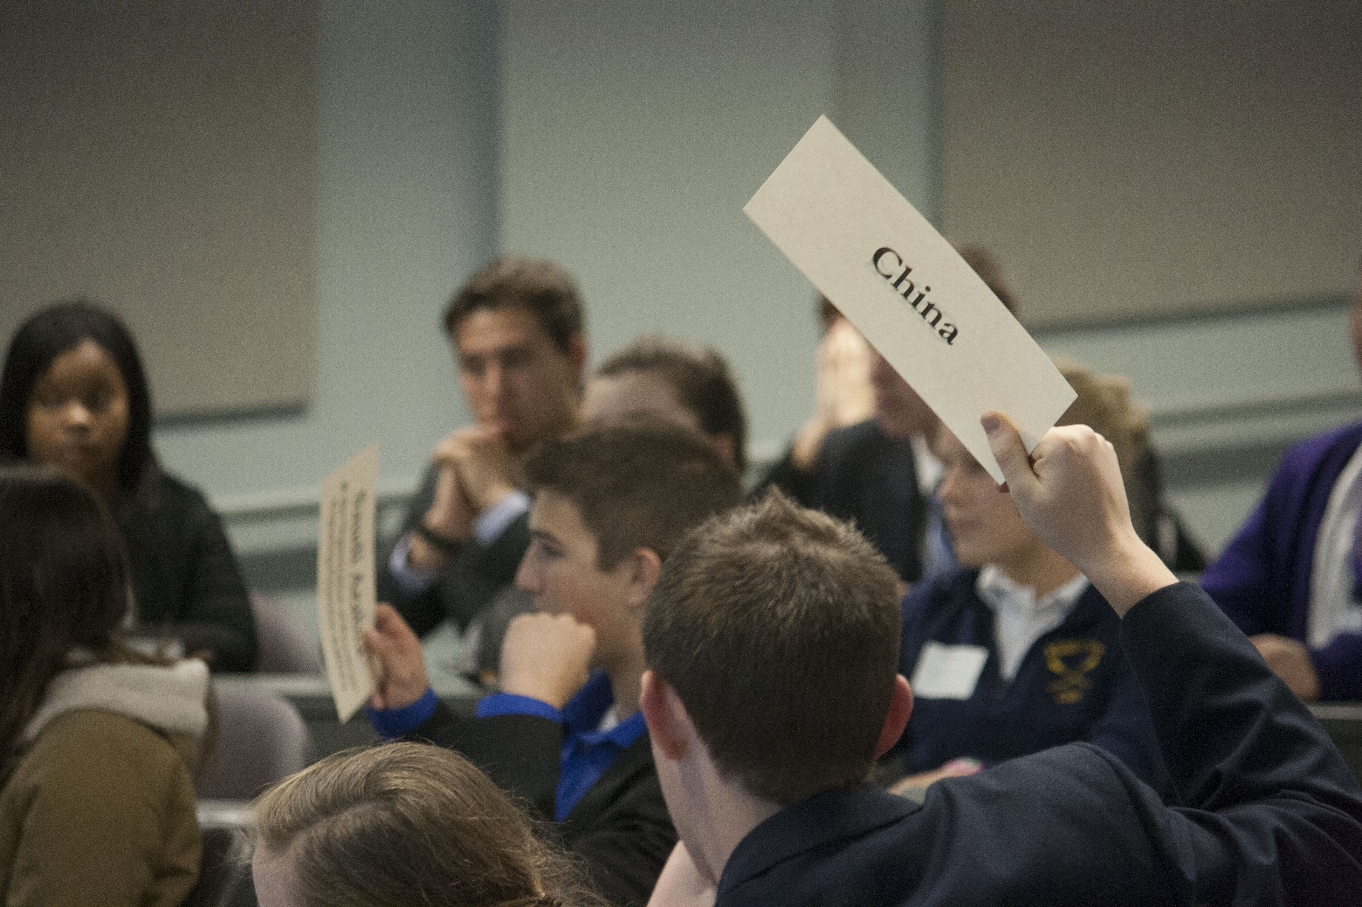
International Climate Summit

